Slide 1
5. Concepts of Enzymology

Slide 2
Pedagogical Objective:
By the end of this course, you should be able to:
Define what an enzyme is
Know the 6 different classes of enzymes
Know the definition of Km and Vmax as well as the parameters modifying enzyme kinetics
Define the different modes of enzyme regulation

Slide 3
5.1. Définition, classification
5.2. Mécanismes d’action
5.3. Site actif
5.4. Cinétique enzymatique et types de représentation
5.5. Inhibition enzymatique
5.6. Phénomène d’allostérie

Slide 4
Introduction
Living organisms are the site of countless biochemical reactions.
These reactions constitute metabolism, which is the biosynthesis or anabolism and degradation or catabolism of a large number of biological molecules.
These reactions take place under physiological conditions (pH: 7.4 and temperature: 37°C) thanks to the presence of catalysts: enzymes.
Without the presence of enzymes, life would be impossible.
Enzymes therefore play a vital role

Slide 5
V.1. Definition
ENZYMOLOGY
Enzymology is the branch of biochemistry that studies the structural and functional properties of enzymes.

Slide 6
Historical Timeline
1730: Digestion is discovered to be more of a chemical phenomenon than a mechanical one
1850: Pasteur demonstrated that the fermentation of sugar into alcohol by yeast is catalyzed by a substance present in yeast
Enzyme: en = in, zyme = yeast
1897: Buchner extracted the first enzymes from yeast
1929: The first purified and crystallized enzyme was urease
Urea ----urease----> CO2 + 2 NH3
Since then, more than 3,000 enzymes have been described

Slide 7
Définition d’une enzyme :
Biomolecule of protein nature (special case: catalytic RNA ribozymes) having high catalytic power and endowed with specificity.
Globular proteins of high molecular weight.
Existence of enzymatic proteins with tertiary structures.
Others with quaternary structures.
In all cases, great importance of the native spatial structure (concept of active site).

Slide 8
PROPRIETÉS ET CARACTÉRISTIQUES DES ENZYMES
Specificity of Enzymatic Reactions
One of the fundamental characteristics of enzymes is their specificity compared to chemical catalysts.
Hence the concept of the active site of an enzyme
We can consider that the active site has two distinct sites:
A substrate binding or recognition site: Substrate specificity
A site responsible for carrying out the chemical reaction, also known as: Reaction specificity

Slide 9
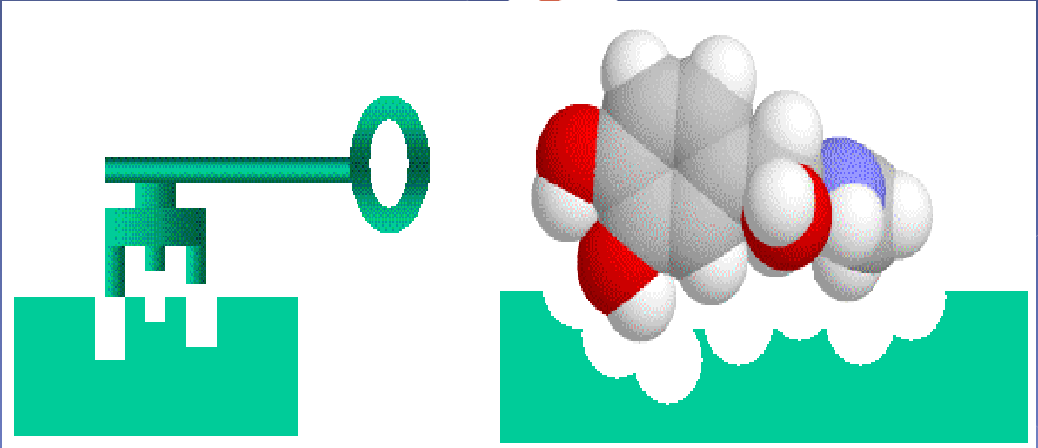
The Molecule that enters into a reaction to be transformed through the catalytic action of an enzyme.
All molecules that enter into an enzymatic reaction and are permanently modified are called substrates.

Slide 10
General Mechanism of an Enzyme
S ⟷ [E] P
An enzyme (E) transforms a substrate (S) into product (P).
First step: The substrate binds to the enzyme
S ⟷ ES
Second step: catalysis. The substrate is transformed into product
ES ⟷ EP
Third step: The product is released
EP ⟷ E+P
K₁
K₋₁
K₂
K₋₂
K₃
K₋₃
If there are multiple substrates, the reaction will proceed step by step (and not simultaneously) to be effective and through a designated active site.

Slide 11
Active site is a deep buried pocket
It is a magic pocket
Instead, the enzyme's active site also recognizes the substrate, but does so in a complementary way to match and stabilize the transition state.

Slide 12
Enzymes are proteins:
They can be composed solely of amino acids (holoenzymes), example: digestive enzymes.
Very often they are heteroproteins made up of a protein part (substrate recognition or catalysis) and a non-protein part (prosthetic group) responsible for activity.
Vitamins are often found as prosthetic groups (in this case called Coenzymes), or other ions (in this case called Cofactors).

Slide 13
The Cofactors
Of inorganic nature: metallic ions such as Mg2+, Mn2+, Cu2+, Zn2+, Fe2+... +; are sometimes necessary for enzymatic activity in the three-dimensional structure of the enzyme
A prosthetic group is called the cofactor that is strongly bound to the enzyme (sometimes with a covalent bond

Slide 14
The Coenzymes
Coenzymes are organic molecules that are essential to the reaction, either by enabling substrate transport or by participating in the enzyme's structure.
Generally derived from vitamins

Slide 15
International Nomenclature
The enzyme name is followed by 4 numbers separated by periods.
The first number corresponds to the class.
The second corresponds to the subclass which specifies the reaction type.
The 3rd and 4th numbers specify the type of substrate used
Example: Glucokinase = EC 2.7.1.1
Glucokinase = EC 2.7.1.1
Class 2: Transferase
The acceptor is glucose
Transfer of a phosphate group
(kinase)
Transfer to an alcohol function
(-OH)

Slide 16
Classification of Enzymes
In 1961, the Enzyme Commission (E.C) established a classification and systematic nomenclature based on the biochemical reactions catalyzed by enzymes. The six classes are:
E.C.1: Oxidoreductases, which catalyze oxidation-reduction reactions (such as peroxidase);
E.C.2: Transferases, which transfer a functional group from one molecule to another.
E.C.3: Hydrolases, which hydrolyze chemical bonds.
E.C.4: Lyases, which break bonds while simultaneously forming new ones;
E.C.5: Isomerases, which rearrange the functional groups of a molecule to form isomers.
E.C.6: Ligases or synthetases, which join two molecules together (such as DNA ligases).

Slide 17
Enzyme Kinetics
Enzyme kinetics is the study of variations in reaction rates as a function of substrate concentration.
What is it used for?
It allows to determine:
Modeling of enzyme activity
Rate equation
Kinetic parameters and their significance
Studies in the presence of inhibitors, optimal conditions...

Slide 18
Enzyme kinetics over time
In classical enzymology, we focus on the stationary (linear) phase by measuring the initial velocity.

Slide 19
Michaelis-Menten Kinetics

Slide 20
Michaelis-Menten Kinetics

Slide 21
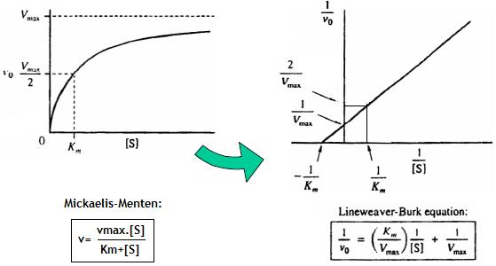
Lineweaver-Burk Representation
The transformation of the Michaelis-Menten equation proposed by Lineweaver and Burk consists of taking the inverses of both its terms. By performing some simple mathematical operations, the equation becomes that of a linear function of the type y = ax + b.

Slide 23
Unit of Enzymatic Activity
S → P mmol
vₒ = [P]/min
International Unit (I.U.) It is the amount of enzyme that catalyzes the transformation of one mmol of substrate per minute
S.A.: relates the number of enzymatic units to the weight (mg) of purified protein.
M.N.: is the number of moles of substrate transformed (or product formed) per mole of enzyme per minute.
K cat (K₂) Catalytic constant that represents the number of moles of P formed per second per mole of enzyme. If the enzyme has multiple catalytic sites, the unit changes and is expressed per mole of sites. Kcat = Vmax / mole

Slide 24
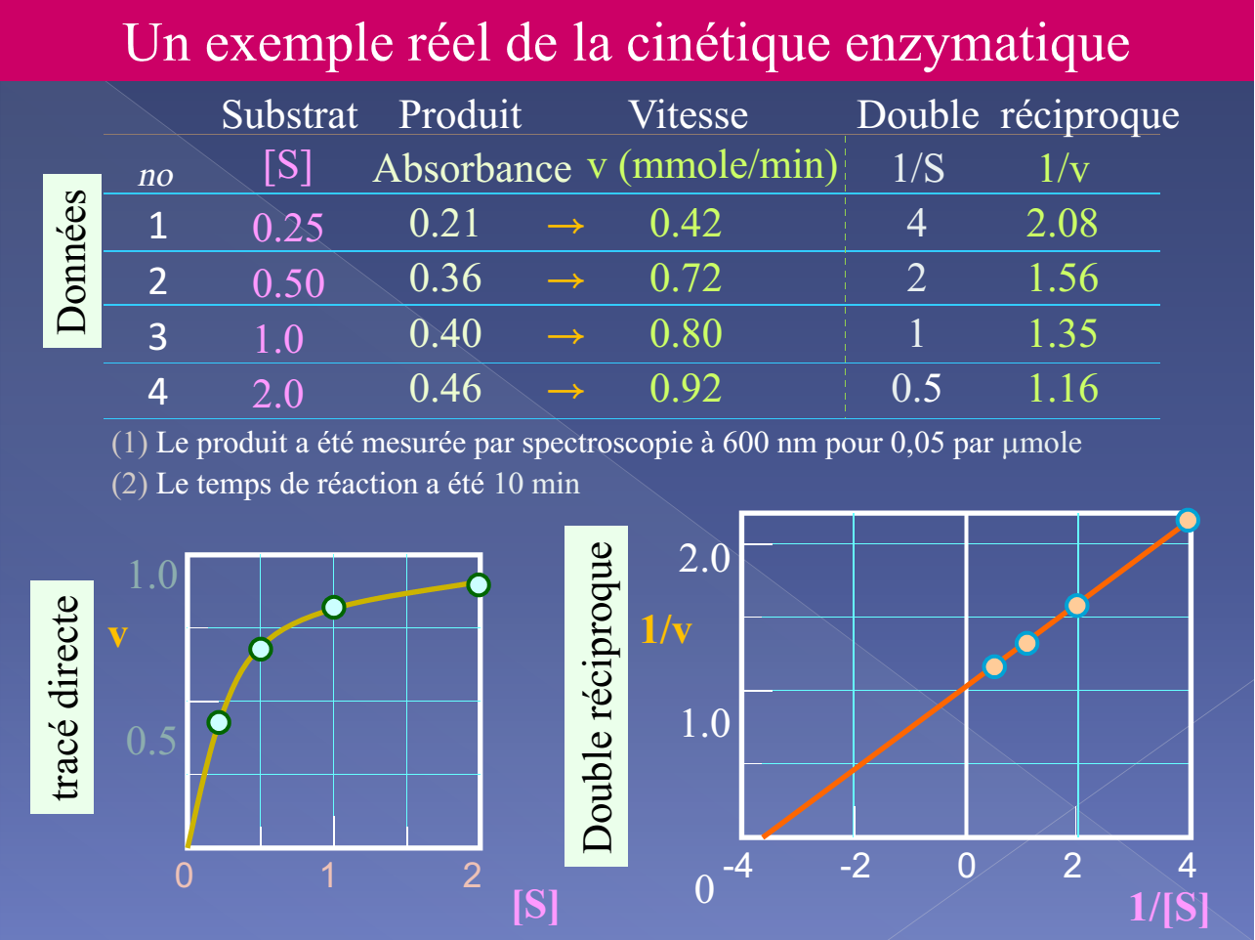

Slide 25
What influences enzymatic activity?
Many factors modulate enzyme activity:
Environmental conditions
Physicochemical parameters: temperature, pH, ionic strength,
Chemical parameters: metals, denaturing agents, covalent modifications, proteolysis
2. Cofactors and Coenzymes
3. Enzyme inhibitors

Slide 26
Effect of pH on enzymes
Enzymes are sensitive to changes in pH of the environment. In fact, when the pH changes, the ionization state of charged groups changes, both in the enzyme's active site (according to the pKa specific to each charged residue participating in the constitution of the active site) varies.

Slide 27
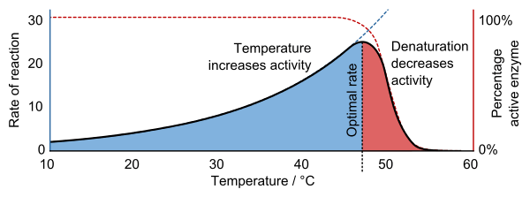
Effect of temperature on enzymes
Generally, denaturation is negligible below 30°C and begins to be noticeable above 40°C. Some enzymes maintain significant activity at temperatures well above 40°C, as is the case with enzymes from thermophilic bacteria.

Slide 28
Reversible Inhibition of Enzymes
1- Competitive Inhibition
Type of inhibition most frequently encountered;
I [inhibitor] is very similar to S [substrate] (analogous structure)
I and S compete for the same binding site on the enzyme: the active site;
Vmax does not change: at very high [S], I becomes negligible;
Km is modified (Km' or Kmapp)

Slide 29
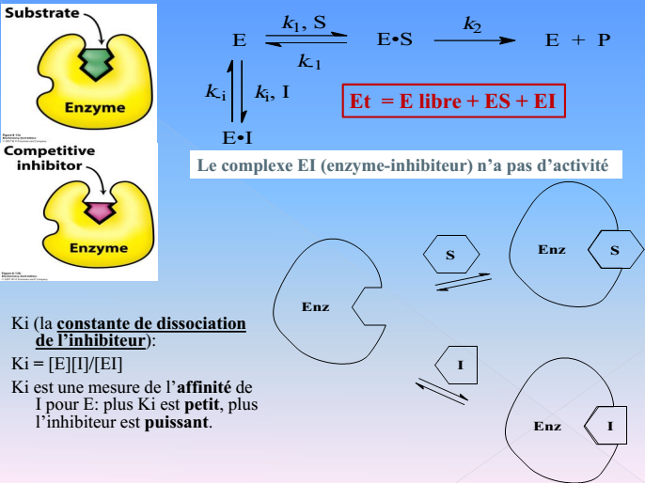

Slide 31
Competitive inhibition

Slide 32
2. Non-competitive inhibition
We speak of a non-competitive inhibitor when the inhibitor binds to both the enzyme E and the enzyme-substrate complex ES, independent of substrate binding.
The non-competitive inhibitor binds to a site completely different from the enzyme's active site → no competition between the substrate and the inhibitor.
There is a decrease in maximum velocity without any modification of Km because there is no competition between the substrate and the inhibitor for the active site.

Slide 35
3. Uncompetitive Inhibition
The uncompetitive inhibitor never binds to the free enzyme but only to the ES (enzyme-substrate complex) and prevents the formation of products. The binding of the substrate to the enzyme causes a modification of the enzyme, thus revealing a binding site for the inhibitor. The inhibitor, in turn, modifies the conformation of the enzyme's active site, and prevents the reaction.

Slide 37
Km' = Km / (1 + [I]/Ki)
1/Vm' = 1/Vmax / (1 + [I]/Ki)
Where:
Km = Original Michaelis constant
Km' = Apparent Michaelis constant in presence of inhibitor
[I] = Inhibitor concentration
Ki = Inhibition constant
Vmax = Maximum reaction velocity
Vm' = Reaction velocity in presence of inhibitor

Slide 39
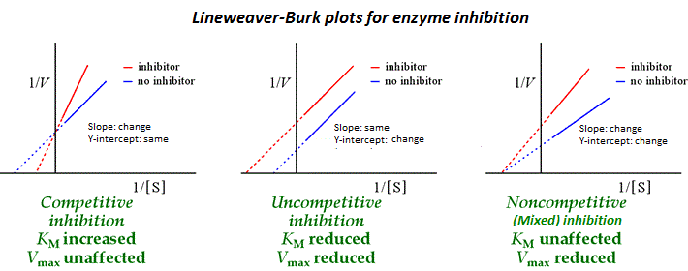

Slide 40
Allosteric Enzymes
Some enzymes do not show a hyperbolic relationship between Vi (initial velocity) and [S] (substrate concentration) but rather a sigmoidal one.
Unlike Michaelian enzymes, allosteric enzymes only exert their action at high substrate concentrations.
Small quantities of substrate are slowly transformed.

