Slide 1
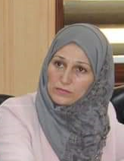
ORGANIZATIONS
Dr.DJOUDI Hanane
Faculty of ECMS/ University of Biskra
October, 2024
REF: Business vocabulary in use

Slide 2
A

Slide 3
B

Slide 4
C

Slide 5
D

Slide 6
EX 1

Slide 7
EX 2

Slide 8
EX 3

Slide 9
Thanks

