Slide 1
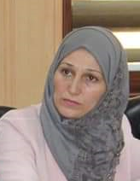
STRATEGIC THINKING
Dr.DJOUDI Hanane
Faculty of ECMS/ University of Biskra
February, 2025
REF: Business Vocabulary in Use-Advanced

Slide 2
A

Slide 3
A

Slide 4
B

Slide 5
c

Slide 6
EX 1

Slide 7
EX 2

Slide 8
EX 3

Slide 9
OVER TO YOU

Slide 10
Thanks

