Slide 1
Morohology of Roots, Stems, Leaves and its modifications

Slide 2
1. Morphology of Roots and its modifications

Slide 7
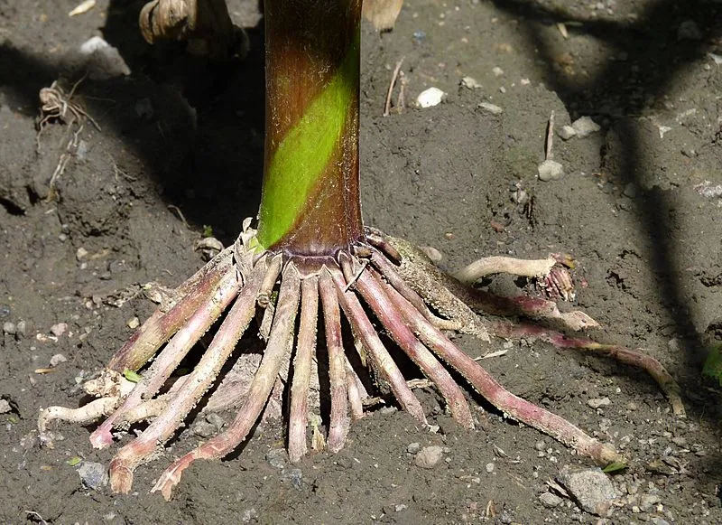

Slide 8
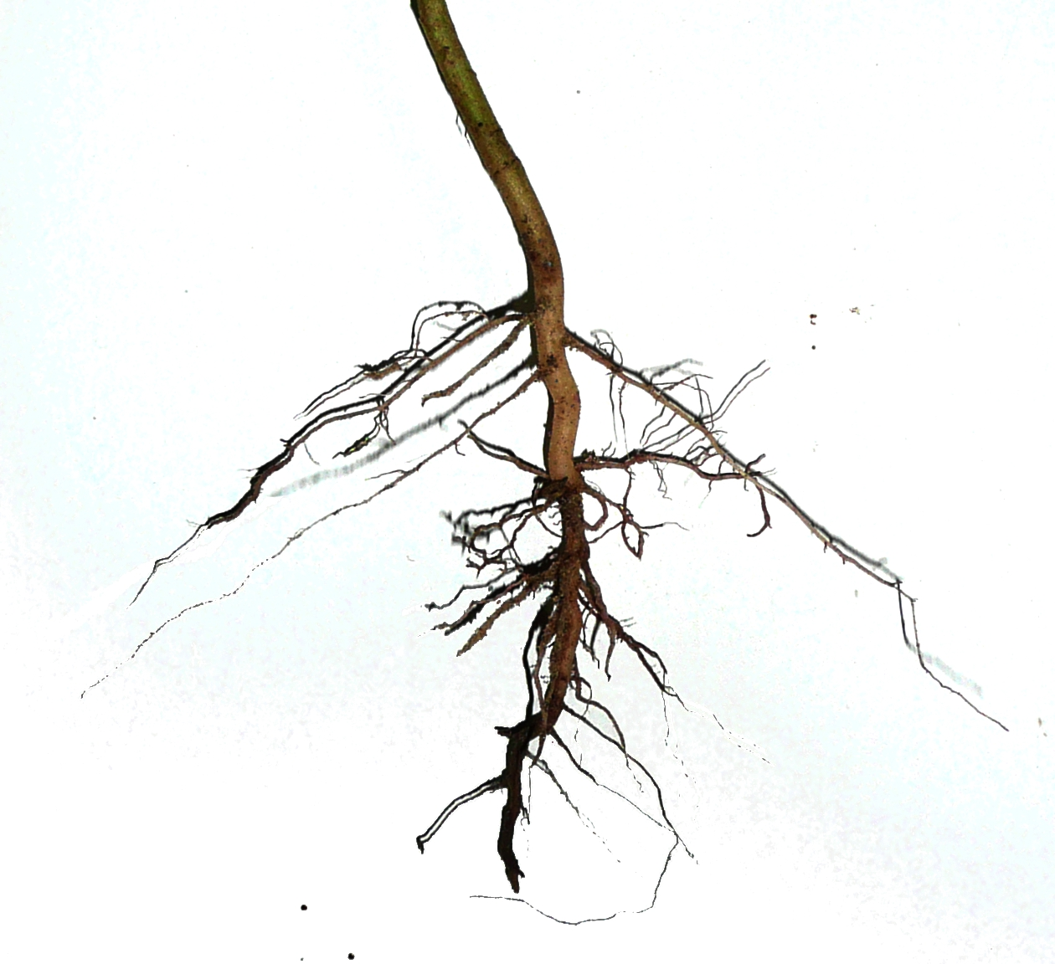

Slide 31
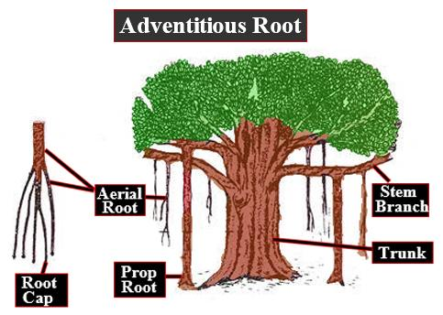

Slide 32
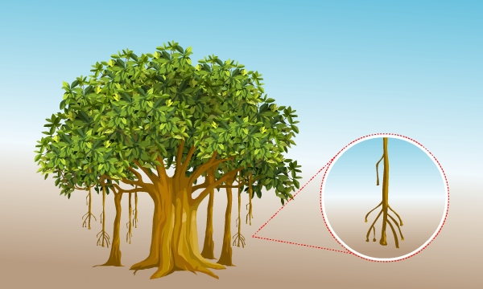

Slide 38
2. Morphology of Stems and its modifications

Slide 39
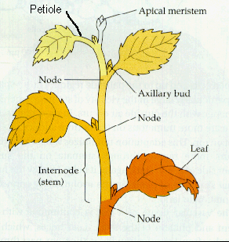

Slide 40
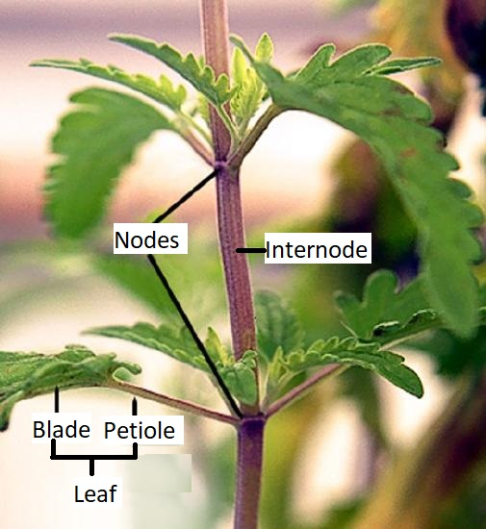

Slide 41
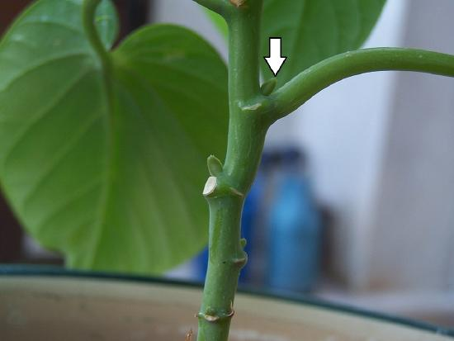

Slide 43
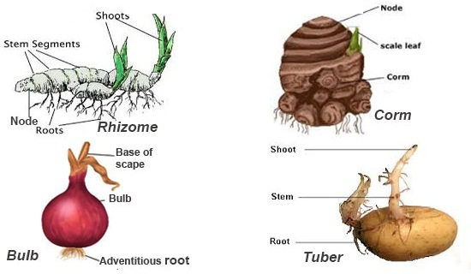

Slide 45
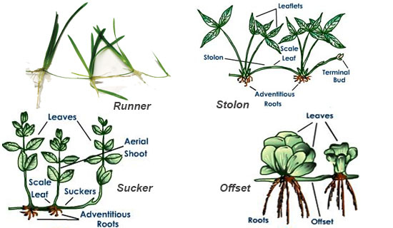

Slide 46
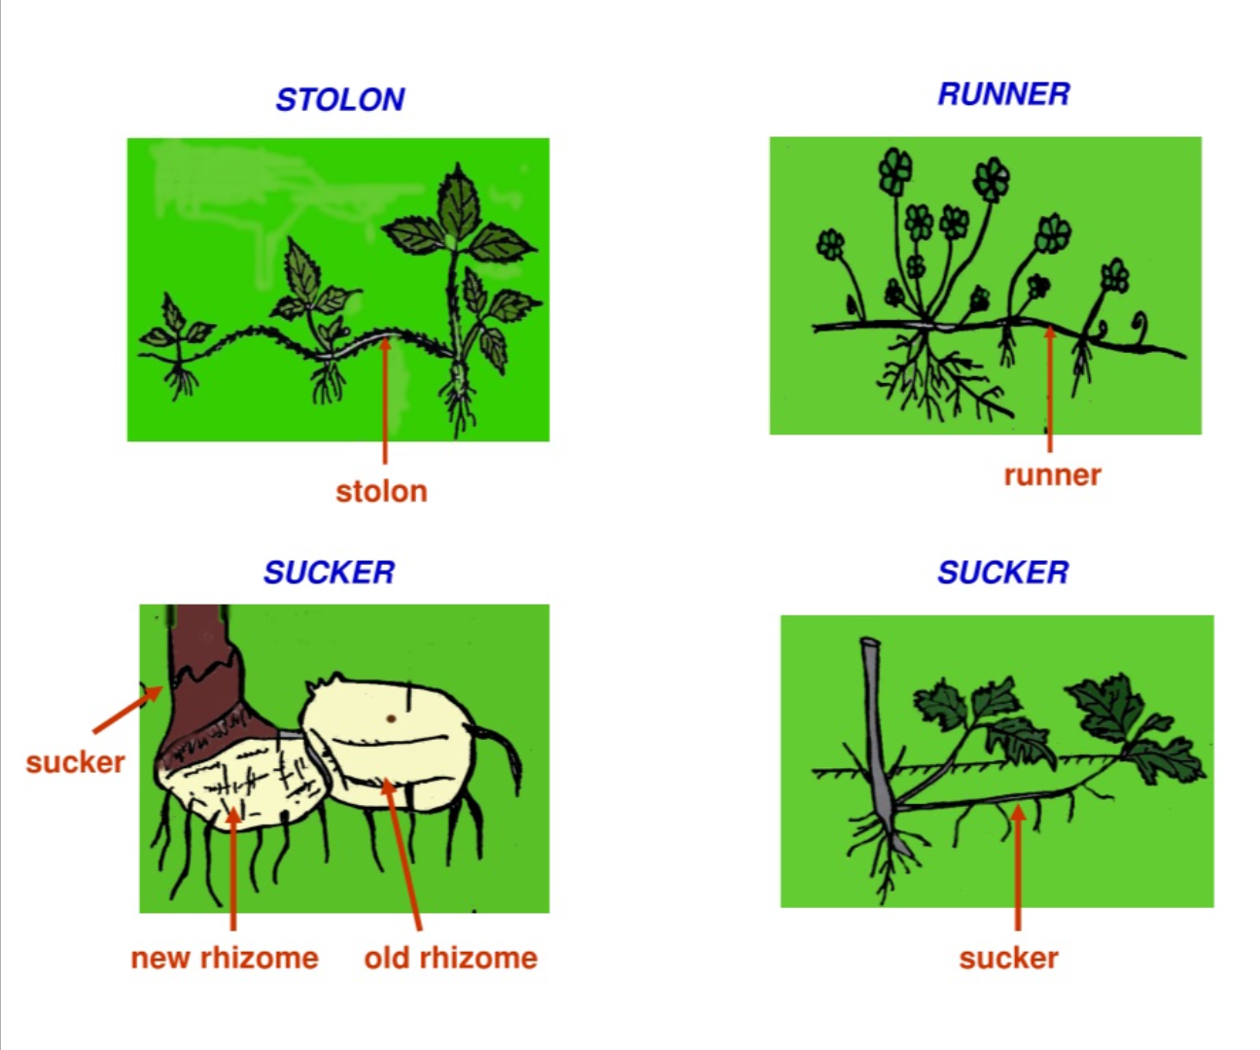

Slide 49
3. Morphology of Leaves and its modifications

