Slide 1
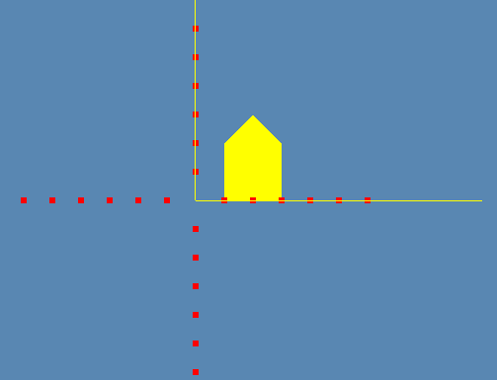
Exemples
glColor3f(1,1,0);
glBegin(GL_QUADS);
glVertex3d(1,0,0);
glVertex3d(3,0,0);
glVertex3d(3,2,0);
glVertex3d(1,2,0);
glEnd();
glBegin(GL_TRIANGLES);
glVertex3d(1,2,0);
glVertex3d(3,2,0);
glVertex3d(2,3,0);
glEnd();

Slide 2
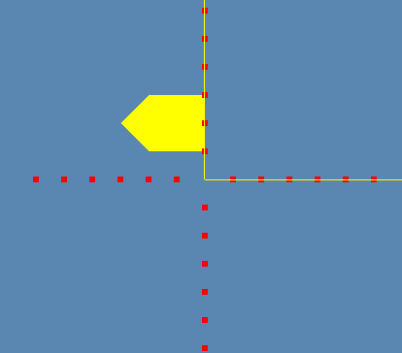
Exemples
Rotation?

Slide 3
Exemples
glColor3f(1,1,0);
glRotatef(90,0,0,1);
glBegin(GL_QUADS);
glVertex3d(1,0,0);
glVertex3d(3,0,0);
glVertex3d(3,2,0);
glVertex3d(1,2,0);
glEnd();
glBegin(GL_TRIANGLES);
glVertex3d(1,2,0);
glVertex3d(3,2,0);
glVertex3d(2,3,0);
glEnd();

Slide 4
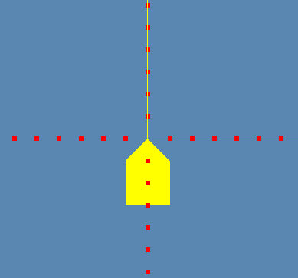
Exemples
Translation?

Slide 5
Exemples
glColor3f(1,1,0);
glTranslatef(-2,-3,0);
glBegin(GL_QUADS);
glVertex3d(1,0,0);
glVertex3d(3,0,0);
glVertex3d(3,2,0);
glVertex3d(1,2,0);
glEnd();
glBegin(GL_TRIANGLES);
glVertex3d(1,2,0);
glVertex3d(3,2,0);
glVertex3d(2,3,0);
glEnd();

Slide 6
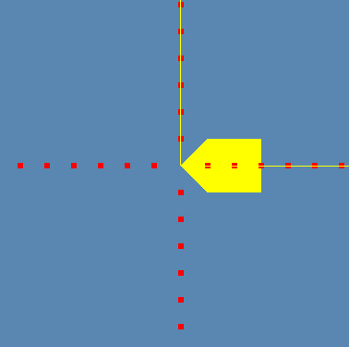
Exemples
?

Slide 7
Exemples
Translation
T((-2,-3,0)
Rotation
Rz(90)

Slide 8
Exemples
glRotatef(90,0,0,1);
glTranslatef(-2,-3,0);
glColor3f(1,1,0);
glBegin(GL_QUADS);
glVertex3d(1,0,0);
glVertex3d(3,0,0);
glVertex3d(3,2,0);
glVertex3d(1,2,0);
glEnd();
glBegin(GL_TRIANGLES);
glVertex3d(1,2,0);
glVertex3d(3,2,0);
glVertex3d(2,3,0);
glEnd();

Slide 9
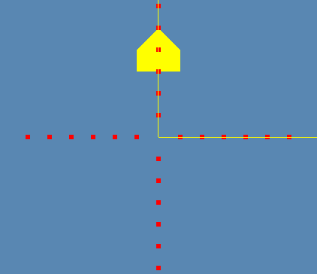
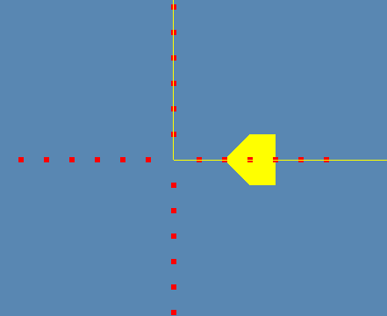
Exemples
Scène 1
Scène 2
Donner la suite des transformations géométrique pour passer de la scène 1 à la scène 2

Slide 10
Exemples
glRotatef(90,0,0,1);
glTranslatef(0,-7,0);
glColor3f(1,1,0);
glBegin(GL_QUADS);
glVertex3d(-1,3,0);
glVertex3d(-1,4,0);
glVertex3d(1,4,0);
glVertex3d(1,3,0);
glEnd();
glBegin(GL_TRIANGLES);
glVertex3d(-1,4,0);
glVertex3d(1,4,0);
glVertex3d(0,5,0);
glEnd();

