Slide 1
Project Management
Project Management

Slide 2
1)- definitions of Project Management
It is the process of leading the work of a team to achieve goals and meet success at a specific time.
It is the science and art of organizing all the components of a project.
It is the application of skills, experience, knowledge, methods, and processes to achieve the objectives of a project

Slide 3
A project has a specific beginning and end. In other words, it is temporary. It also has specific scope and resources. A project is also unique in that it is not a routine business operation.

Slide 4
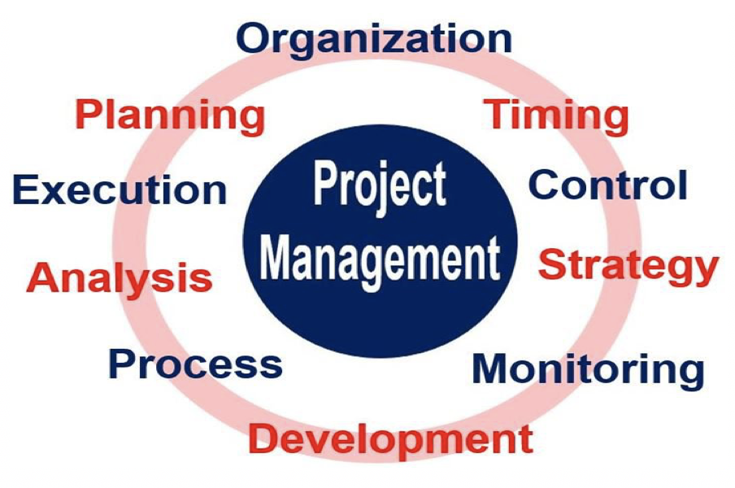
A project management requires:

Slide 5
2)- Project management core components
The following core components form part of project management:
Defining why the project is necessary or important.
Estimating how long it will take to complete and specifying the quality of deliverables. Also, listing what the project requires and what resources to use.
Justifying the investment by preparing a business case.

Slide 6
Developing a management plan for the project.
Leading and motivating all team members.
Managing any project changes, issues, or risks.
Tracking the project’s progress against the original plan.
Making sure the project is within budget.
Liaising with stakeholders and the project organization.
Getting all the relevant people to agree to the project

Slide 7
What is a project manager?
A project manager is a professional who plans and organizes resources and personnel. They must make sure they complete the project on time and within budget. They must also ensure that the project meets the requirements of the business.

Slide 8
How to become a successful project manager
Work on your people skills.
Communicate like a pro.
Identify employees strengths and weaknesses.
Build project management experience.
Be proficiently always on track.
Do not be a know it all person.
Believe in your team and your project.
Pull ideas from everyone.

Slide 9
Project Manager Duties?
A project manager’s typical duties include estimating project work, building project plans, and monitoring project scope and progress. They also make sure everyone’s clear on project status and expectations and typically organize and facilitate project meetings

Slide 10
.
Perhaps the most important responsibility a project manager fulfills, however, is managing relationships with the people involved in a project. A good project manager works hard to keep team morale up and ensure stakeholders stay happy from project start to finish.

Slide 11
Question
In your view, what are the characteristics of a good projet manager?

