Slide 1
Questionnaires
Pr. Saliha Chelli

Slide 2
Learning objectives
In this lecture, students will be introduced to:
the types of questionnaires
the types of questions that can be used in a questionnaire close-ended and open-ended)
the format of a questionnaire
The lay out of a questionnaire
the types of questions to be avoided
how to validate and pilot the questionnaire
Strength and weaknesses of the questionnaire

Slide 3
Introduction
One of the most common methods of data collection in second language (L2) research is to use questionnaires of various kinds. The popularity of questionnaires is due to the fact that they are easy to construct, extremely versatile, and uniquely capable of gathering alarge amount of information quickly in a form that is readily processable (Dornyei, 2003). The field of questionnaire design is very vast. This course provides an introduction to its key elements.

Slide 4
Definition
Questionnaires are any written instruments that present respondents with a series of questions or statements to which they are to react either by writing out their answers or selecting from among existing answers. "
questionnaires are often referred to under different
'batteries, ' 'checklists, ' 'scales, ' 'surveys, ' 'schedules, ' 'studies, 'profiles, ' 'indexes/indicators, ' or even simply 'sheets' (Aiken, 1997).

Slide 6
Types of questions to be yielded by questionnaires
Types of questions
Factual
(age, gender, race, marital status, socio-economic status..)
Behavioural
(actions, lifestyles, habits, personal history…)
Attitudinal
(questions showing different attitudes)

Slide 7
Types of questionnaires
The researcher can select several types of questionnaires, from highly structures to unstructured. They are often referred to as
Closed-ended questionnaires (structured). This type of questionnaire is used to generate statistics in quantitative research and can be scanned straight forward into computer for ease of analysis.
Open-ended questionnaires (unstructured). This type is used in qualitative research. The questionnaire does not contain boxes to tick but instead leaves a blank section to write in an answer. . As there are no standard answers to these questions, data analysis is more complex.
Combination of closed-ended and open-ended questionnaires (semi-structured). Many questionnaires begin with closed questions, with boxes to tick or scales to rank, and end with open questions for more detail response

Slide 8
Type of questions I. close-ended questions Close-ended questions require pre-defined answers or a choice from options.
1. Dichotomous questions: Yes/no, true/false Dichotomous questions are a type of survey questions that provides two options, while generally it is true that the more response options an item contains, the more accurate evaluation it can yield. There might be cases when only a polarized yes-no or true-falso decision can be reliable.

Slide 9
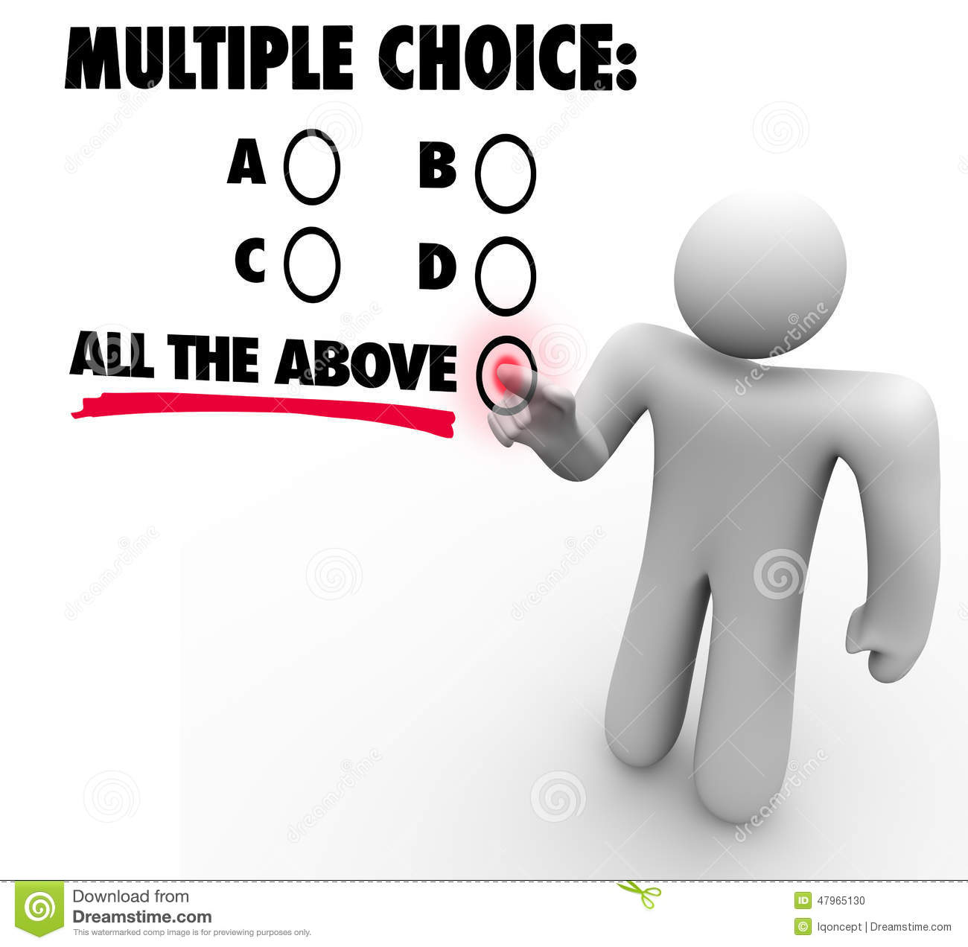
2. Multiple choice: It is familiar because of its popularity.

Slide 10
3. Semantic differential scales: in this technique, respondents are asked to by marking with a tick or an ‘X’ between two bipolate adjectives at the extreme

Slide 11
For each pair of adjective, place a cross between to express the extent to which the adjective descibes someone.
Clean : : : : : dirty
Honest : : : : : dishonest
Kind : : : : : cruel
Fair : : : : : biassed
Strong : : : : : weak
Energetic : : : : : lazy
Reliable : : : : : unreliable

Slide 12
4.Likert scales: the most famous type of closed ended items is the ‘Likert scale which consists of a characteristics and the respondents are asked to indicate the extent to which they agree or disagree with it by ticking or circling. For example:
A Likert scale was developed in 1932 by Rensis Likert, a psychologist, to better understand the feelings of respondents given a balanced set of choices.
It allows researchers to gain insights on perceptions, behaviors, feelings and more by asking respondents to self-report their reactions based on how they feel using the Likert scale.

Slide 13
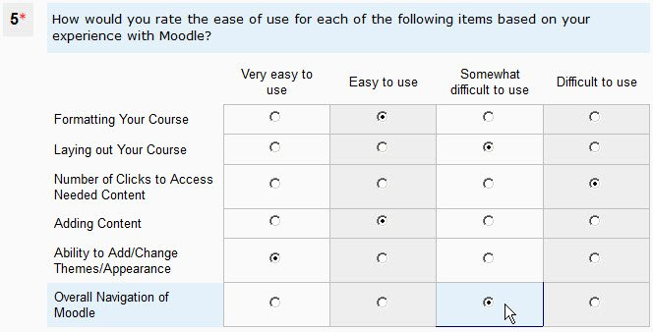

Slide 15
5.Rank order items
The rank order question is akin to the multiple choice question, but it asks respondents to identify priorities.
For example: please indicate your priorities by placing numbers in the boxes to indicate your views, 1= the highest priority; 2= the second highest priority and so on (see the examples in Cohen et.al., 2007:325)

Slide 16
6. Rating scales: They provide a range of responses to a given question or statement.
Numerical scales give so many marks out of so many, that is assigning one of several numbers (which corresponds to a series of ordered categories).

Slide 17
Open-ended questions: open-ended questions include items where the actual question is not followed by response options.
This kind of questions works well if they are not completely open but contain certain guidance.

Slide 18
Rules about item wording The format of your questions will affect the anwers; keep them short and understandable.
Use short and simple items
Use simple language
Avoid ambiguous and loaded words and sentences.
Avoid negative constructions
Avoid double-barreled questions
Avoid items that are likely to be answered in the same way by eveybody.
In a rating scale, better to include both positively and negatively word items
(DÖrnyei, 2003)
Avoid jargon ( words not usually used)
Avoid leading questions ( containing judgment)
Avoid double negatives

Slide 19
The question type and also the lay out of the questions is of a great importance.

Slide 20
The main parts of a questionnaire
Title: like any other piece of writing, a questionnaire should have a title to identify the domain of the investigation.
General introduction: ‘the opening greeting’ usually describes the purpose of the study. The important functions of this section involve emphasizing that there are no right or wrong answers and saying ‘thank you
Specific instructions: these explain and demonstrate how respondents should go about answering the questions.

Slide 21
Questionnaire items
Questionnaire items: These constitute the main body of the questionnaire. They need to be very clearly separated from the instructions. This is where different typefaces and font styles are useful.
Additional information: at the end of the questionnaire, we may add information such as contact name.
Final ‘thank you.

Slide 22
Grouping and ordering items
Item sequence is a very significant factor.
The items should seem as a series of logically organized sequences, hence, we need to follow some organizing principles.
The item format: items of the same type need to be clustered together into well-marked sub-sections, seperated from each other by a clear instruction to highlight the format change for the respondent.

Slide 23
Follow up
The initial part of the questionnaire, as any other piece of writing is very imporatnt as it sets the tone.
The first opening questions need to be easy and intersting.
Factual questions come next
Real open questions that require substantial and creative writing at the end

Slide 24
Lay out and length of the questionnaire
Layout: It is an important aspect. Three points in particular are worth bearing in mind.
Booklet format
2. Appropriate density: it refers to how much we put on a page
3. Items sequence: we need to decide on the order of items.
The opening questions need to be interesting, relatively simple and at the same time focusing on important aspects.
Using closed-ended at beginning and open-ended at the end.
Mixing up the scales creates a sense of variety and prevents respondents from repeating previous answers.
Length: Most researcher agree that anything that is more than 4-6 pages long and requires over half an hour to complete may be considered too much.

Slide 25
Before the administration of the questionnaire, the following steps are compulsory.
Validation ot the questionnaire
to make sure the questionnaire measures thaT it measures what it aims to measure
Piloting of the questionnaire
The questionnaire should be administered to a small number from the population to check its feasibility

Slide 26
To validate the questionnaire, the following questions are addressed.
Is the questionaire measuring what it intended to measure?
Does it represent the content?
Is it appropriate for the sample/ population?
Is it comprehensive enough to collect all the information
Is it comprehensive enough to collect all the information needeed to address the purpose of the study?
Does it look like a questionnaire?

Slide 27
How can the questionnaire be validated?
Face validity
This can be checked by experts who evaluate whether the questionnaire effectively capture the topic under investigation
Internal consistency
This can be checked through a standard test called Conbrach’s Alpha (CA) which ranges from 0 to 1.0.
The values should be at least 0.70 or higher.

Slide 28
Ways of administering the questionnaire
Selt- administered
By mail
One-to one administartion
Group administration

Slide 29
Strength and weaknesses of questionnaires
Strenghts
Collect large amounts of data about people’s attitudes and perceptions.
Supply standardized answers
practical
Economical
Easier to be administer
Easy analysis and visualization…
Weaknesses
People may not tell the truth/ the researcher has no opportunity to check the truthfulness
Limited responses
Poor response rate
Poorly completed answers
Unreliability
Illegibility …

Slide 30
References
Descombe, M. ( 2003). The good research guide for small-scale social research projects, 2nd edn. Maidenhead: Open University.
Cohen, L, Manion, L & Morison, K. ( 2007). Research methods in education. New York: Routledge.
DÖrnyei, Z. (2003). Questionnaires in second language research: Construction, administration and processing. London: Lawrance Erlbaun Associate Publishers.
DÖrnyei, Z. (2007). Research methods in applied linguistics: Quantitative, qualitative &mixed methodologies. Oxford: Oxford University Press.

Slide 31
Appendices Checklist for planning a questionnaire

Slide 32
Checklist for the production of a questionnaire (Descombe 2003)

Slide 33
Questions examples ( Descombe, 2003)

