Slide 1
Mohamed Kheider University of Biskra Faculty of Economics, Commerce and Management Sciences Department of Commercial Sciences
Subject: English Language Teacher: Mekhloufi Rania
Grade: 3rd Year LMD International Commerce 2020/202 Group: (1,2,3)
LESSON 3:
Simple Present Tense

Slide 2
1/ The Form of Simple Present:
The PRESENT TENSE uses the verb's base form: verb stem (write, work....), except, for third-person singular
subjects. In which we use the base form of the verb plus an -s ending (he writes, she works).
In the simple present tense, negative forms and question forms are made using the auxiliary verb “do”.
Negative form:
Negatives in the simple present are formed by adding do not, and with third-person singular subjects we use does not before the simple form of the verb (verb stem):
Auxiliary Subject Example
Do I I do not sing.
Do you you do not sing.
Does he he does not sing.
Does she she does not sing.
Does it it does not sing.
Do we we do not sing.
Do they they do not sing.
In other words, only third person singular subjects (he, she and it) have doesn't — the rest have don't.

Slide 3
Question Form:
Forming a yes/no question:
Yes/no questions are also created using the auxiliary do. This time, the auxiliary is placed before the subject. Here are the rules:
Auxiliary Subject Example
Do I Do I sing?
Do you Do you sing?
Does he Does he sing?
Does she Does she sing?
Does it Does it sing?
Do we Do we sing?
Do they Do they sing?
Forming a WH- question:
WH- questions (using words such as “what”, “when”, and “where”) are also created by putting the auxiliary do before the subject. Then, you add the WH- word at the beginning. Here are some examples:
Statement: Yes/no question: WH- question:
I sing Do I sing? What do I sing?
You fight. Do you fight? Why do you fight?
He lives Does he live? Where does he live?

Slide 4
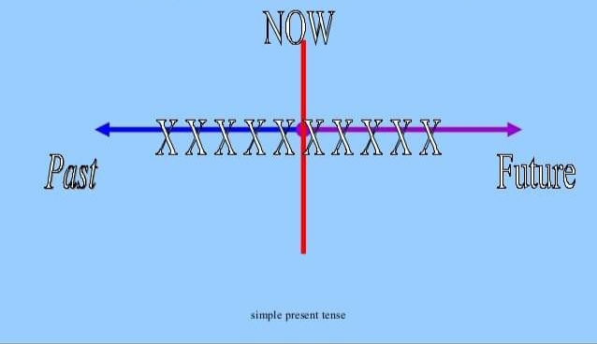
Permanent situations and general truths
The present simple is for actions and situations that are generally or permanently true:
IBM is one o f the largest computer companies in the world; it manufactures mainframes and
PCs, and sells its products all over the world.
Routines/Habits and frequency
We use the present simple to talk about routines and things we do regularly:
I usually get to the showroom at about 8.00 and I have a quick look at my emails.
The sales reps arrive at about 8.15 and we open at 8.30.
2/ The Use of Simple Present:

Slide 5
Facts:
We use the present simple to talk about scientific or other facts:
there are 24 hours a day
Superconductors are materials that conduct electricity and do not create electrical resistance.
A future programmed event:
We use the present simple to talk about programmes and timetables. When we use the
present simple like this, it can refer to the future:
The fast train to London leaves at 7.39 and gets in to Paddington at 8.45. Then you catch the
Heathrow Express to the airport - it goes every fifteen minutes.

Slide 6
3/ Time Indicators of Simple Present
usually,
always,
frequently,
seldom,
never,
two times a week,
every other day,
sometimes,
whenever,
often,
rarely,
everyday,
occasionally

Slide 7
Practice
2.1 Complete the sentences using the following verbs:
cause(s) / close(s) / connect(s) / go(es) / live(s) / speak(s) / take(s)
1 Tanya speaks German very well.
2 Ben and Jack............................................to the same school.
3 Bad driving................................................. many accidents.
4 The museum................................................. at 4 o’clock on Sundays.
5 My parents .................................................. in a very small flat.
6 The Olympic Games ...................................... place every four years.
7 The Panama Canal .......................................... the Atlantic and Pacific oceans.

Slide 8
2.2 Put the verb into the correct form.
1 Julia doesn’t drink (not / drink) tea very often.
2 What time (the banks / close) here?
3 I have a car, but I .................................................(not / use) it much.
4 Where............................................................ (Maria / come) from? Is she Spanish?
5 ‘What.......................................... (you / do)?’ ‘I’m an electrician.’
6 Look at this sentence. What................................................... (this word / mean)?
7 David isn’t very fit. He.............................................. (not / do) any sport.
8 It ....................(take) me an hour to get to work in the morning. How long .......................(it / take) you?

