Slide 1
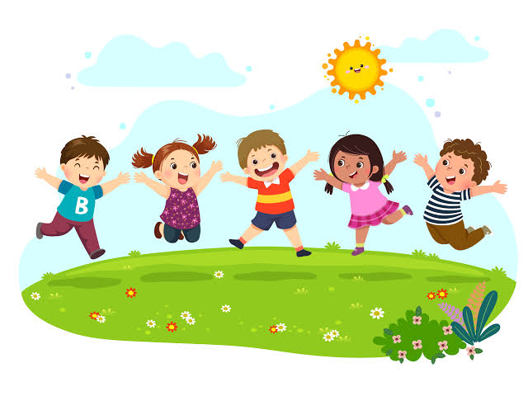
The importance of playing
PEOPLE'S DEMOCRATIC REPUBLIC OF ALGERIA
Ministry of Higher Education and Scientific Research
Mohamed Khider University – BISKRA
Faculty of
Option :
Presented by:
Supervised by:
Habiba Ghechami
kadour Amira
Benamor Fatna

Slide 2
PRESENTATION PLAN
GENERAL CONTEXT
Play concept
Games goals for children
The importance of playing
Types of play
Playing functions
CONCLUSION
2

Slide 3
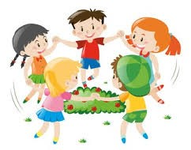
GENERAL CONTEXT
Play is an essential stage in a child's life, especially during his physical, psychological and mental development.
It is also considered a pedagogical and pedagogical means in educating the child, which has emerged clearly in teaching in the pedagogy of approaching competencies, and many thinkers emphasized the importance of playing during teaching.
3

Slide 4
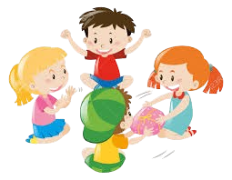
Play concept
Frobel
the founder of kindergartens, believes that play is the highest expression of growth
Humanity in childhood, which is the only free expression of what is going on inside the young child, which is
Essentially the integrated kidney development of the child.
It is an important behavioral activity that plays a major role in forming a personality
The individual and sometimes confirming the group's heritage, which is a behavioral phenomenon in living organisms, and is characterized by them
Susanna Miller defined it
believes that play is a manifestation of the child's mental development that expresses...
The development of his games depends on his level of development and mental and emotional maturity, so he defines it as “a process of acting
It transforms the information received to suit the child's needs
Piaget
5

Slide 5
Games goals for children
•Play is an educational learning method through which the individual can interact with elements of the environmentAnd its assets, which leads to the development of his personality, which affects his behavior with others.
••Play is an educational means through which children understand the meanings and concepts of things, making them...Able to adapt to reality.
•Play is an effective tool that helps to know the individual differences in children in order to be able to teach them According to the abilities and capabilities of each of them.
Play is a therapeutic method that contributes to detecting psychological, mental and emotional disorders In children.
•Playing sports and the health of children’s bodies is the first aid to their development, growth and formation its organs and its maturation.
6

Slide 6
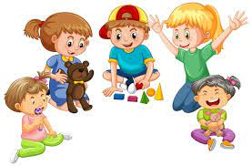
The importance of playing
The importance of play for physical, motor and sensory development:
Strengthening the body and exercising large and small muscles, especially movement games and physical exertion.•
The child learns many motor skills, such as jumping, running, and climbing.
Coordinating and organizing movements and
increasing the ability to balance pressure.
Developing self-concept.
Developing sensory-motor synergy.
7

Slide 7
The importance of playing
The importance of play for mental development:
Providing opportunities for innovation and formation,
especially construction games
Developing sensory perception and the ability to remember, link and insight, foresight and observation.
Increase the child’s knowledge about people and things,
and focus and attention
From a cognitive standpoint, the child’s awareness of the world surrounding
him and his relationship with it increases, as well as an increase in the child’s
linguistic and Cognitive, perceptual and creative.
7

Slide 8
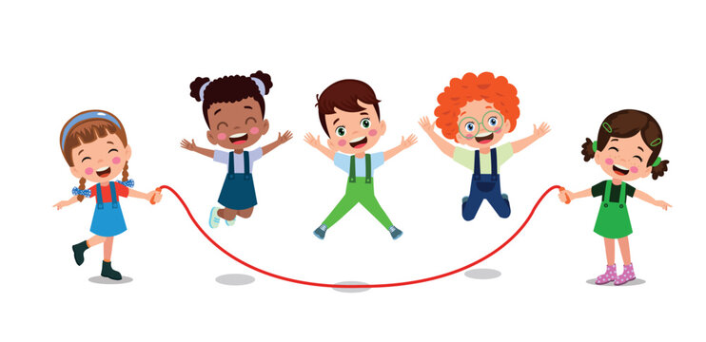
Types of play
Vacant play
It is the first stage from birth to 3 months, and it may not appear to be playing. However, when the child observes his surroundings, he With random movements, it is a prelude to future play exploration.
Single play
A child playing alone teaches him how to entertain himself and enjoy himself, and through it he learns to rely on himself and discover Ways to have fun without the help of others•
Spectator play
The child watches others play. It is common between 2-3 years of age, especially younger children who are developed
Singular accused.•
Parallel play
When two children are playing in the same room, each in his own world, and neither trying to influence the other nor
They care about each other, but in reality they learn from each other even without direct interaction.•
8

Slide 9
Types of play
Cooperative play
It usually begins at the age of 3-4 years, and is characterized by children participating in play and sometimes separately, but they feel
Paying attention to what they do.
Group play
When children play actively together, usually starting from 4-5 years of age or older or among younger children who have
Older siblings or dealing with many children.
Competitive play
The child learns the rules, taking turns as a team, and the concept of winning and losing.•
Construction play
The child learns to handle objects, build them, and put them together.•
Pretend play
When a child plays and acts out the role of characters,his imagination develops and he learns cooperation and taking turns.
9

Slide 10
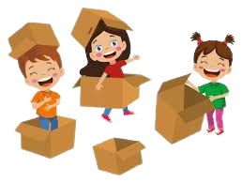
Playing functions
Physical function
Educational function
Play is necessary for muscle growth through motor activity (placing things on top of each other - opening them - closing them - throwing them...)
The child learns a lot through different playing tools, such as his knowledge of different shapes, colors, sizes, and clothes, and
He acquires the rules, behavior, order, discipline, and standards prevailing in his society.
Social and Moral perspective
Biological function
Play is linked to the life of the people and their cultural identity, and is determined by family, political and religious institutions.
It consists in discharging excess biological energy and then restoring a state of biological balance.
9

Slide 11
Playing functions
Personal job function
Psychological and Therapeutic function
Through the player, observers can discover:
The extent of the individual’s social compatibility ,and mental abilities and their development, the extent of the child’s emotional state.
The psychological functions are to assert oneself and express one’s desires. The player is also considered an outlet, giving him psychological comfort, and so on.
Gains more experience and knowledge.
Creative function
The child can develop his creative imagination and discover
Little by little.
9

Slide 12
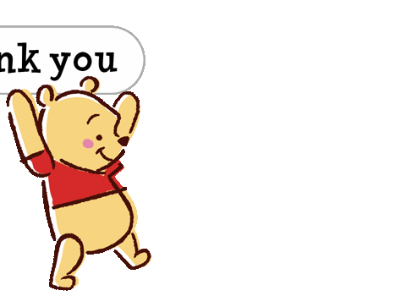

Slide 13
Thank You
ANY QUESTIONS?
NO,Good

